Slide 1

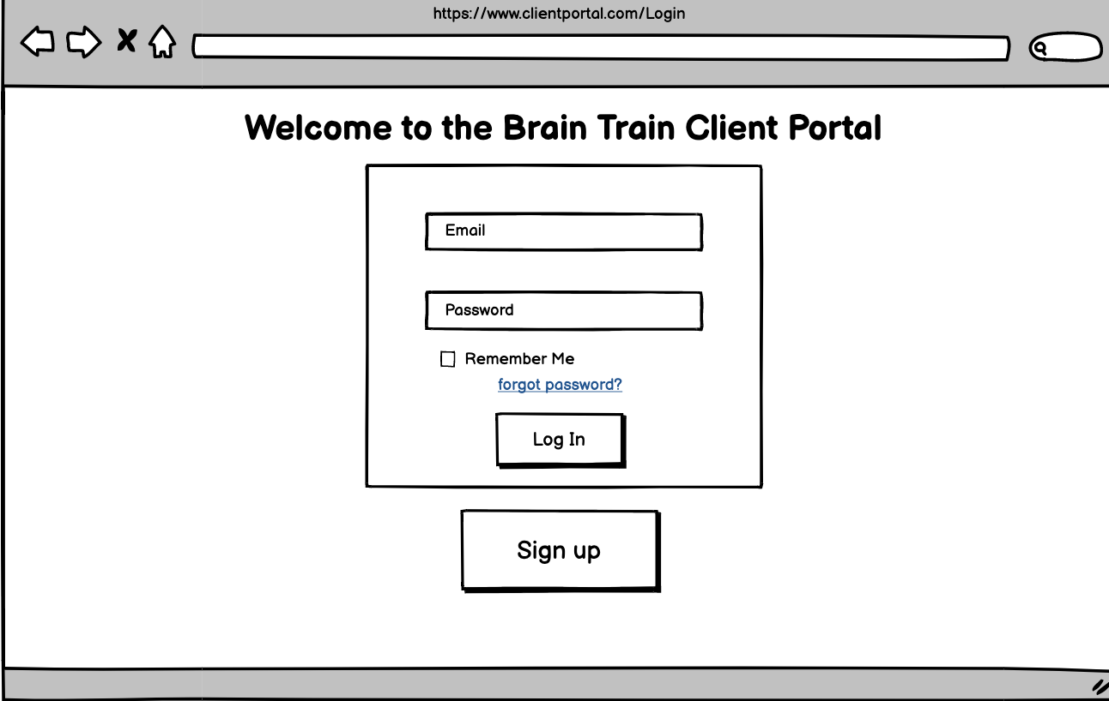
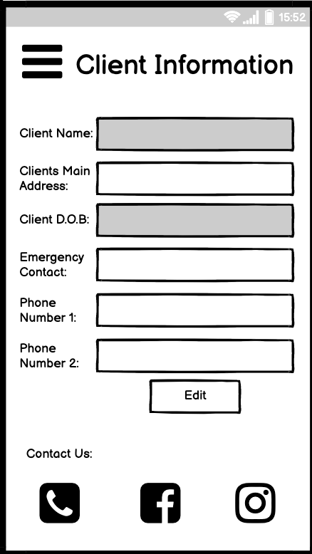
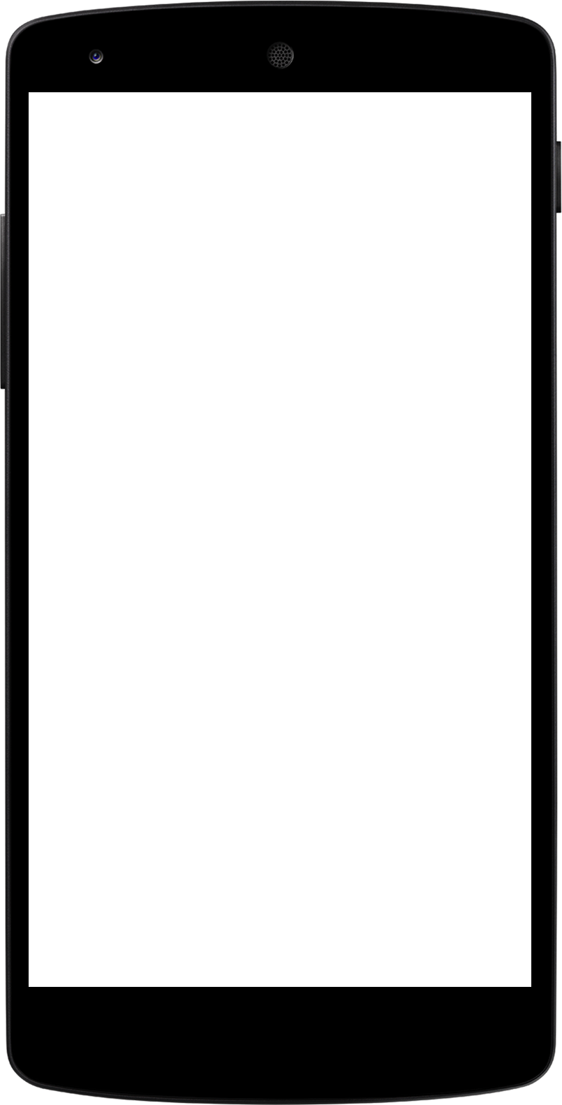
Client Portal App
Connecting your Clients to their bookings

Slide 2
Outline
The Problem
Solution Proposal
Wireframes
Next Steps

Slide 3
The Problem

Slide 4
Online Bookings Suck
Our client exclusively uses phone bookings only, which means clients cannot see when their next appointment is!
While online bookings may be the solution for some companies, this client has specific requirements that prevent them from doing this.
As a result clients continuously forget to book more appointments, or show up without one!

Slide 5

See this is a problem =>

Slide 6

See this is a problem =>

Slide 7

See this is a problem =>

Slide 8
Solution Proposal

Slide 9

So What Can We Do?
We can’t give clients access to online booking, but we CAN give them a list of their upcoming appointments.
Why not add it the ability to say you would like to change an appointment, so they call you back with all the information at hand.
While we are there add in the ability to change other important information like their address and phone number.

Slide 10
Why it’s better than existing solutions
Online booking is the most obvious solution to such a problem, however our client has tried this before. Our client runs a program that relies on their clients booking in for a precise amount of sessions to complete a program...leaving this in the hands of the user left them with incomplete programs all over the place.
By creating a client portal, this solves the problem of knowing when appointments are, as well as allowing clients to request changes to specific appointments when they remember to do something about it when the kids have gone to bed.

Slide 11
Wireframes

Slide 12
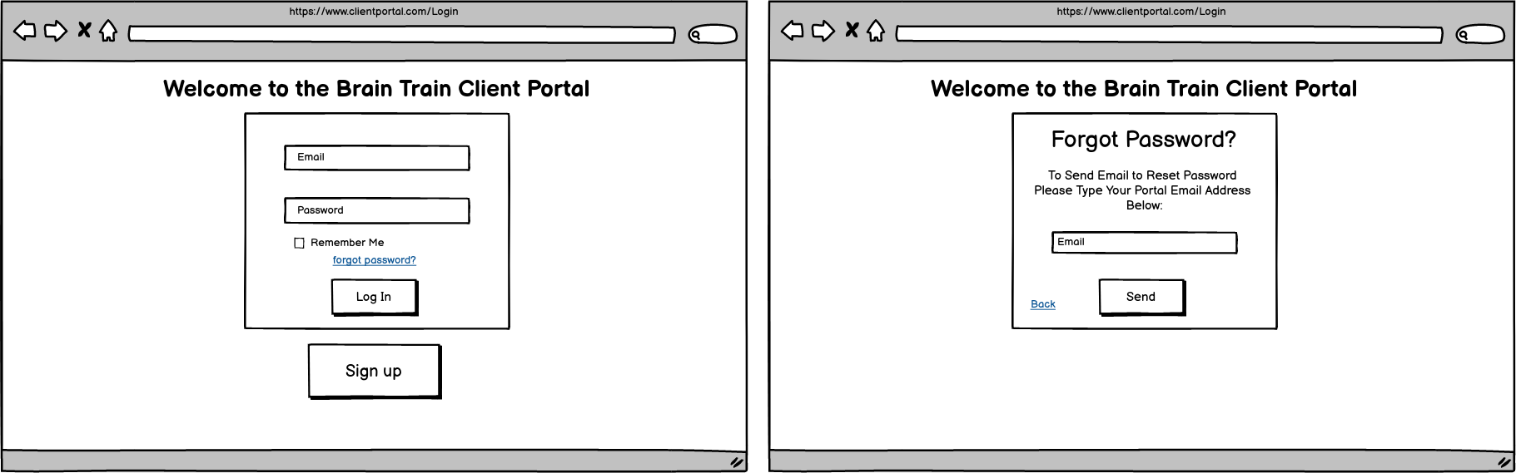
Sign Up

Slide 13
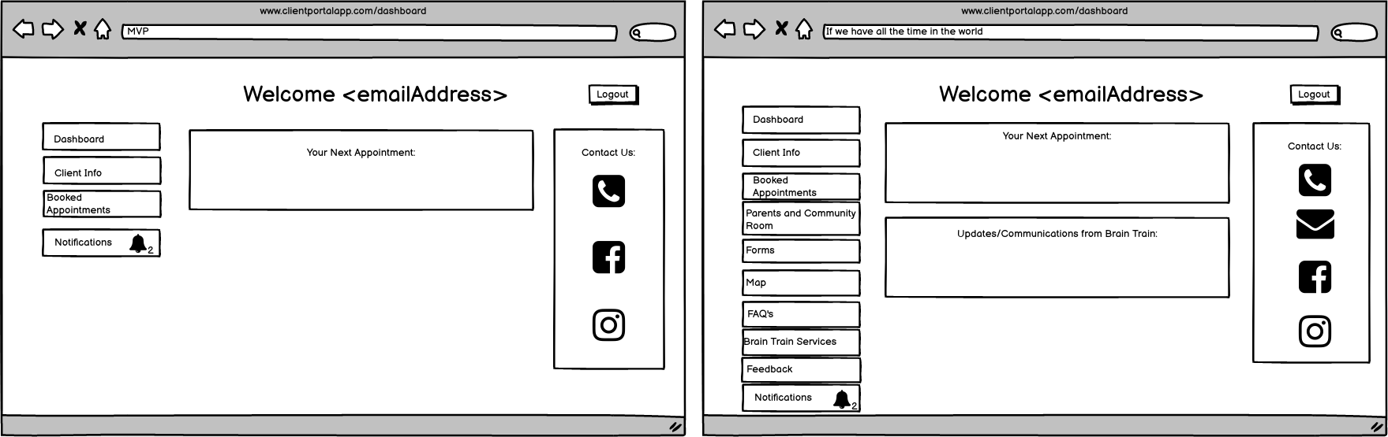
Dashboard

Slide 14
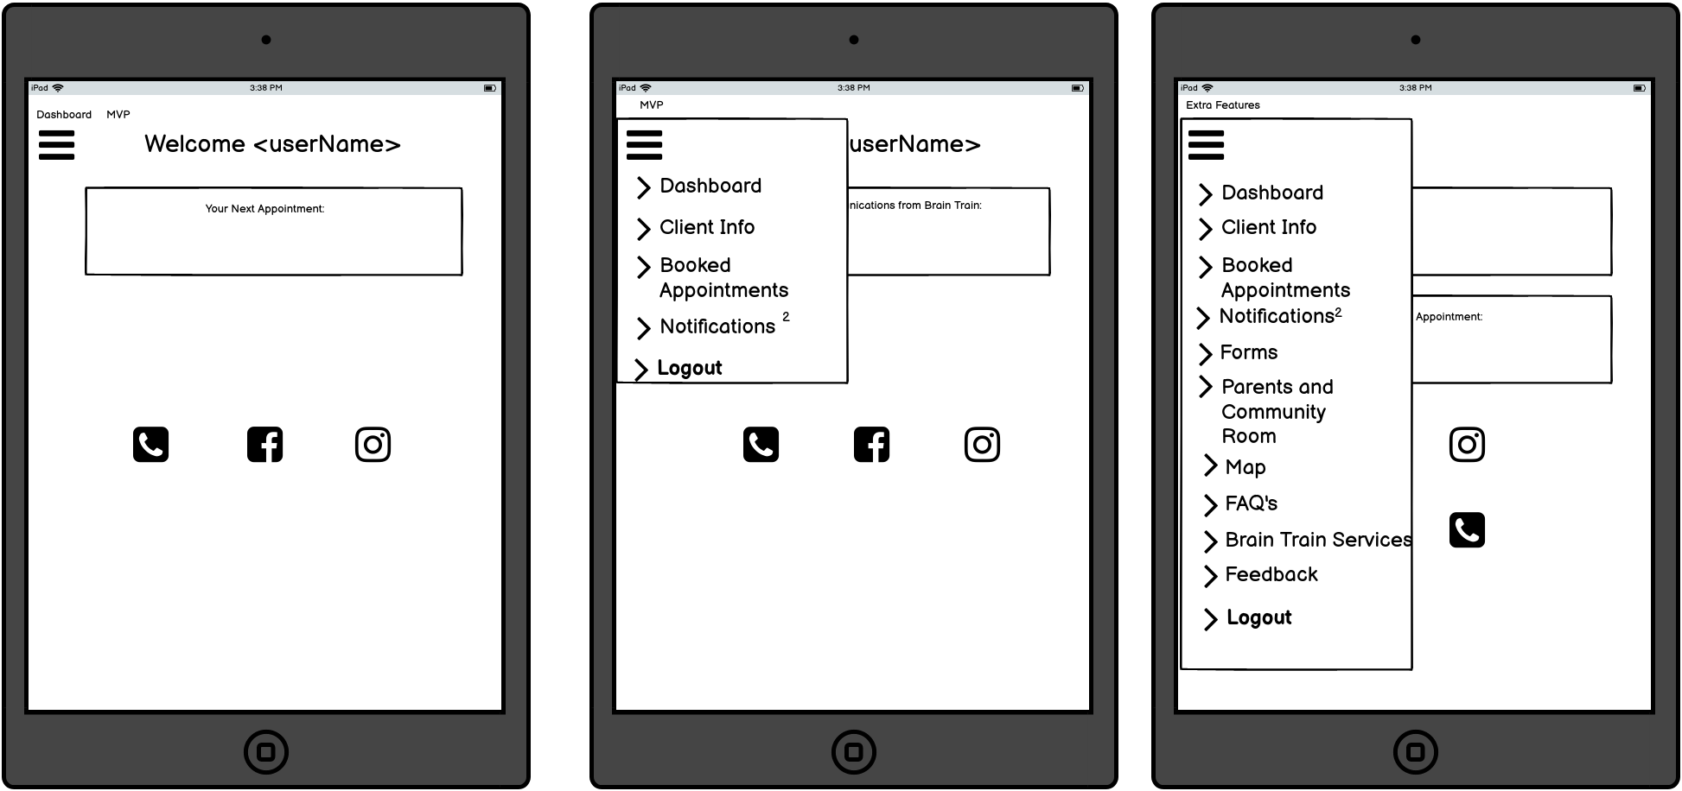
Dashboard (Tablet)

Slide 15
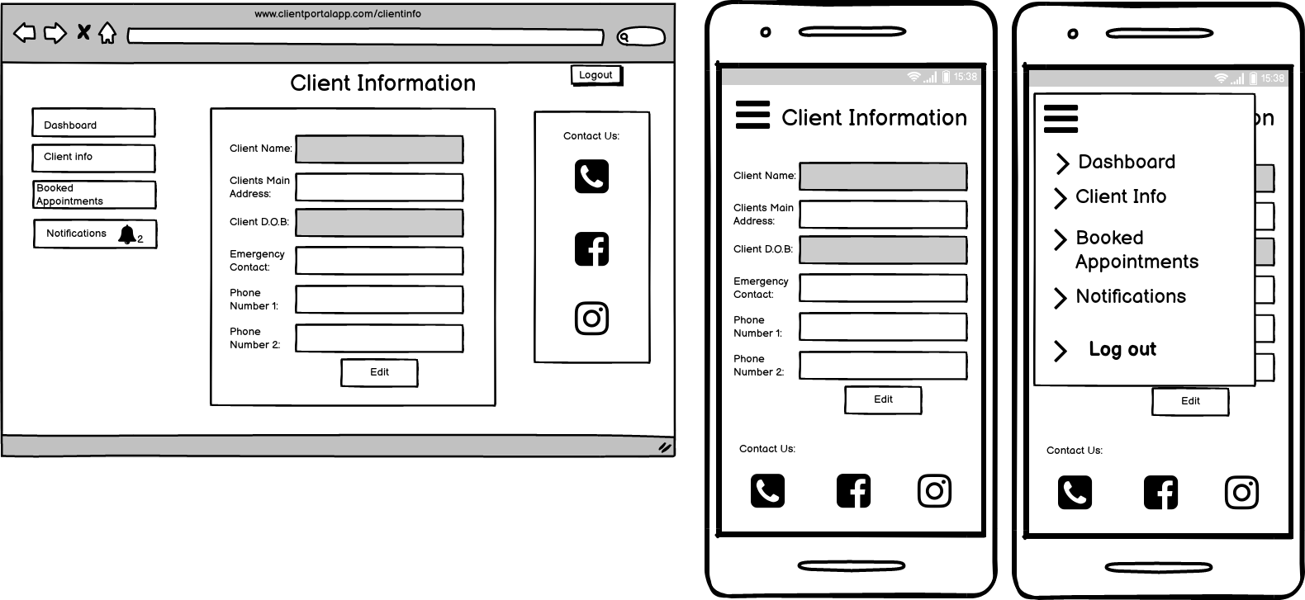
Client Information

Slide 16
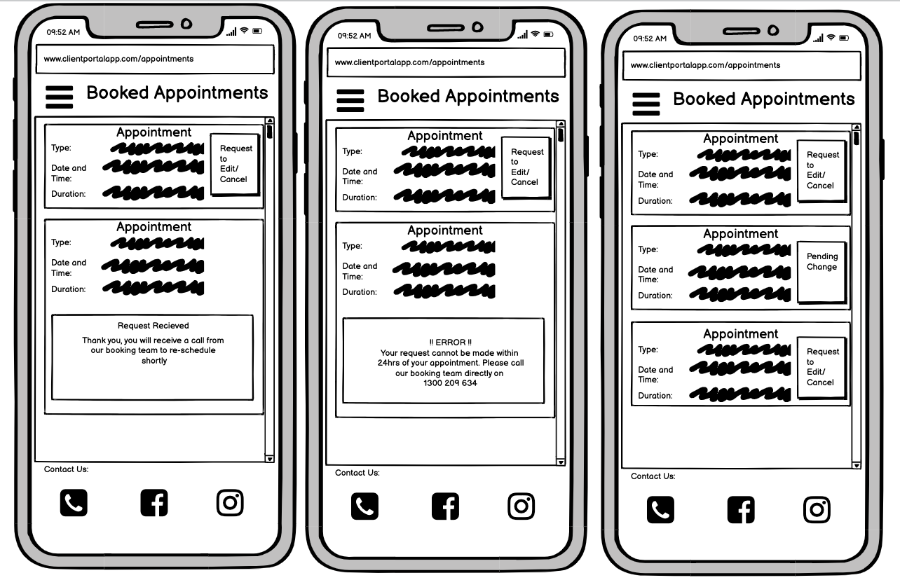
Appointments

Slide 17
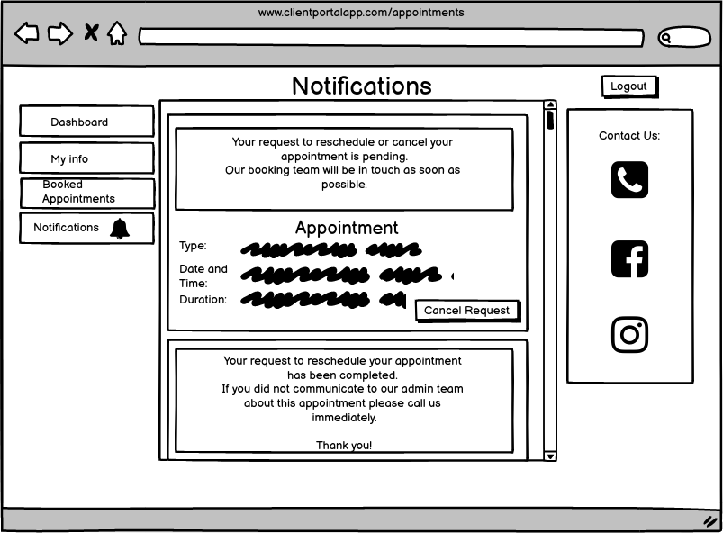
Notifications

Slide 18
Next Steps

Slide 19
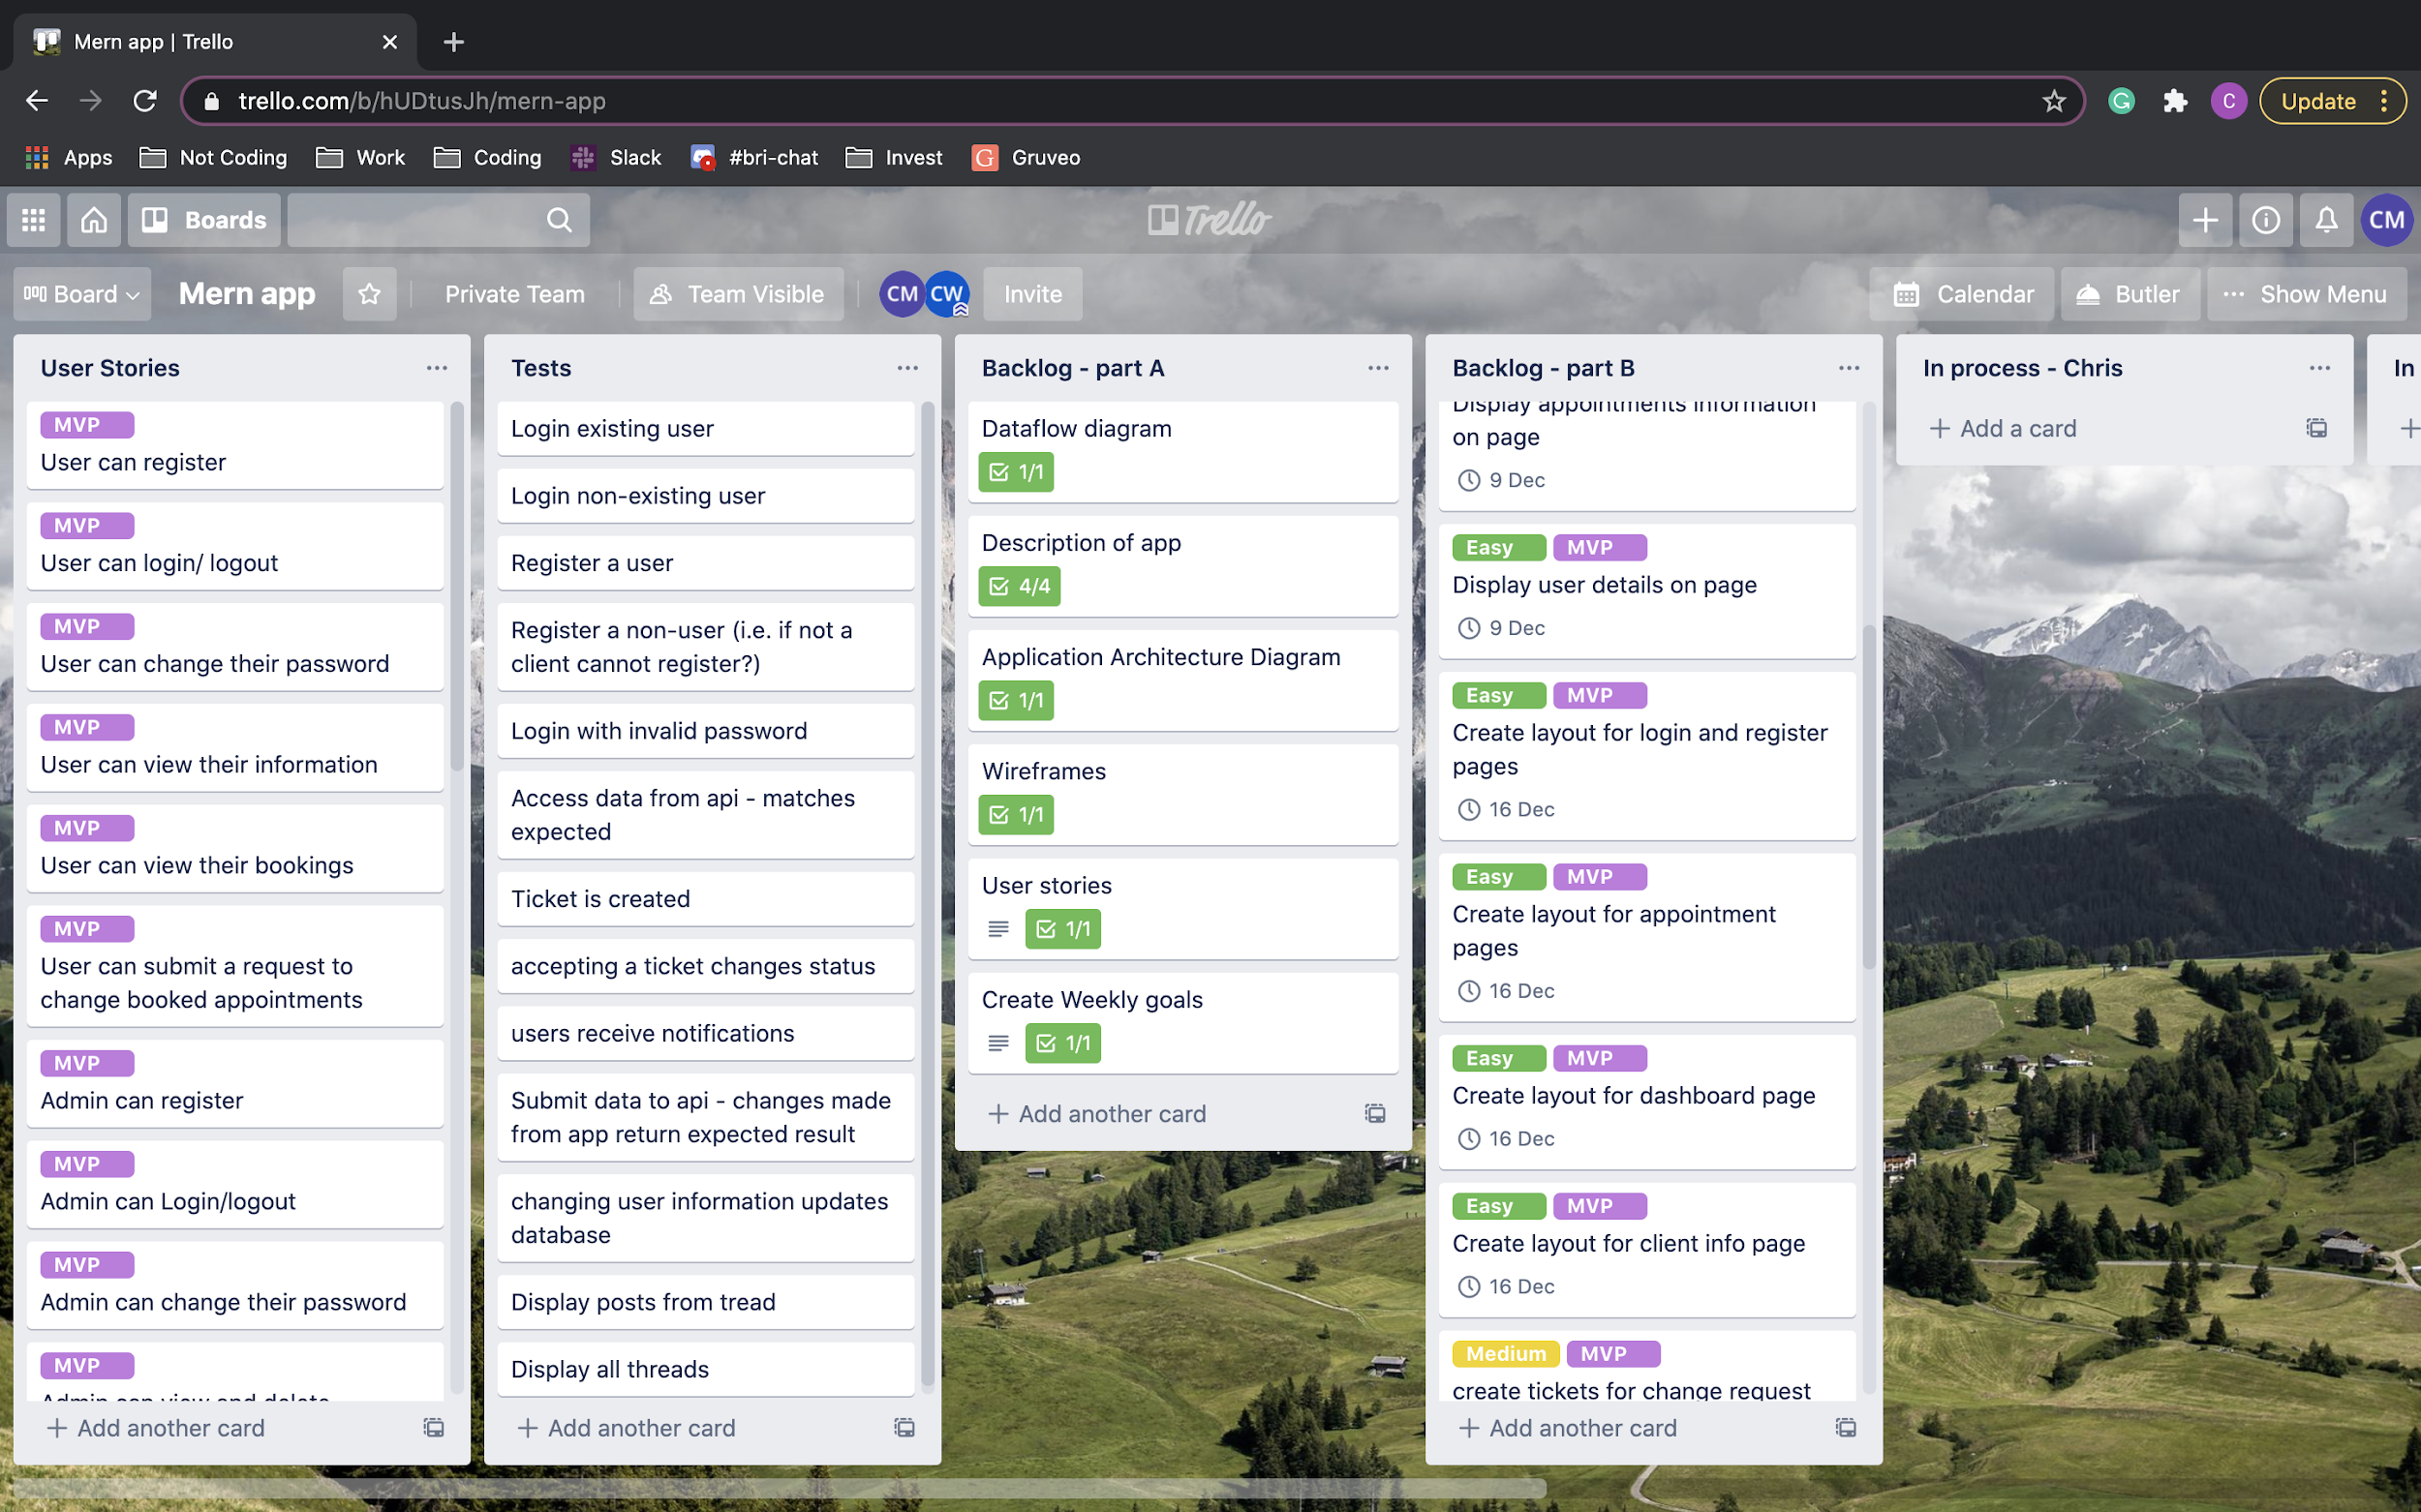
JUST BUILD IT ALREADY!

Slide 20
Questions?

